Slide 1
Chapter 15
Complex Numbers
A few operations with complex numbers were used earlier in the text and it was assumed that the reader had some basic knowledge of the subject. The subject will now be approached from a broader perspective and many of the operations will be developed in detail. To deal with Fourier analysis in Chapter 16, complex number operations are required.

Slide 2
Complex Numbers and Vectors
In a sense, complex numbers are two-dimensional vectors. In fact, some of the basic arithmetic operations such as addition and subtraction are the same as those that could be performed with the spatial vector forms of Chapter 14 in two dimensions. However, once the process of multiplication is reached, the theory of complex number operations diverges significantly from that of spatial vectors.

Slide 3
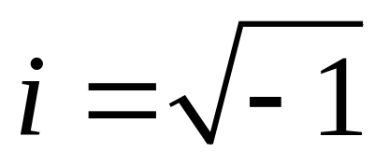
Rectangular Coordinate System
The development begins with the two-dimensional rectangular coordinate system shown on the next slide. The two axes are labeled as x and y. In complex variable theory, the x-axis is called the real axis and the y-axis is called the imaginary axis. An imaginary number is based on the definition that follows.

Slide 4
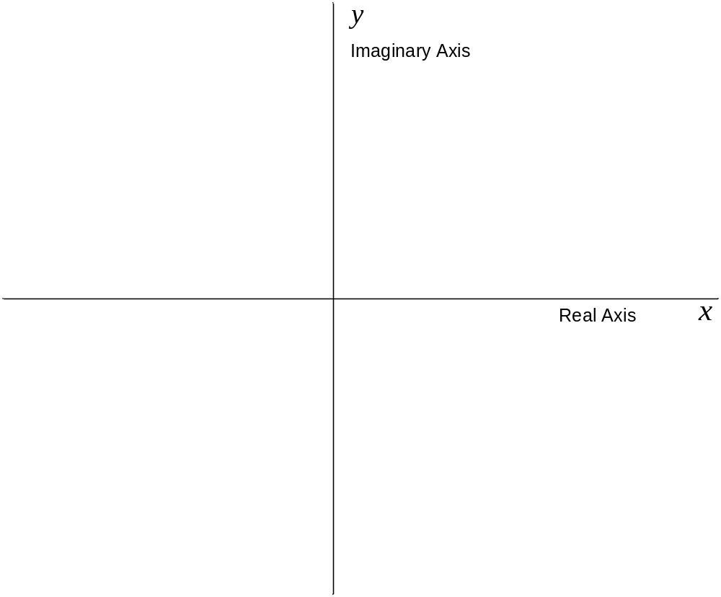
Complex Plane

Slide 5
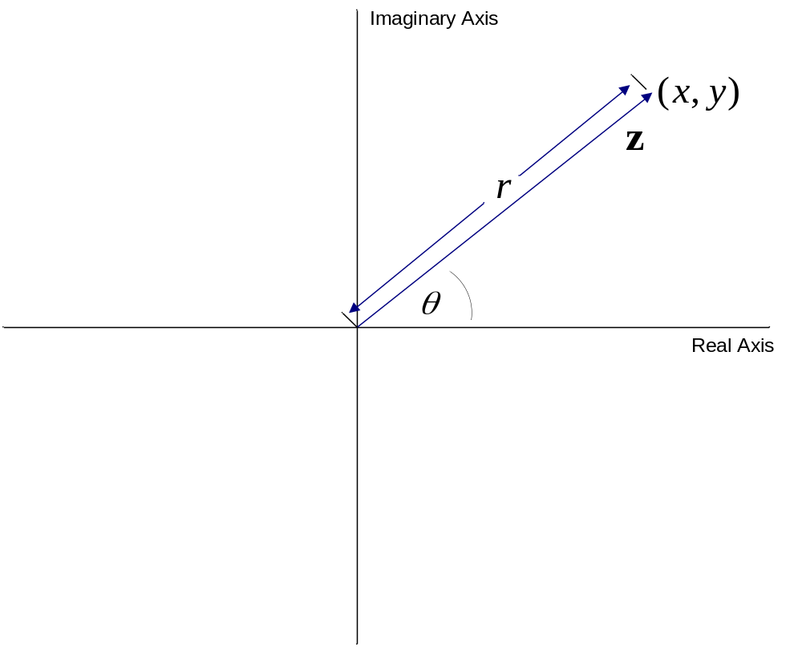
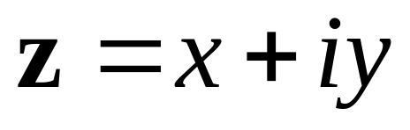
Form of Complex Number

Slide 6

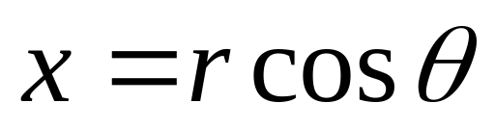
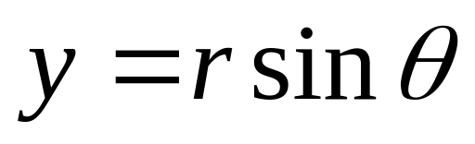

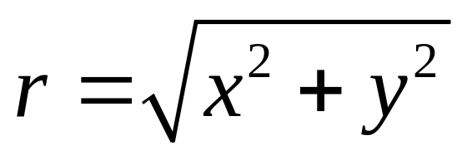
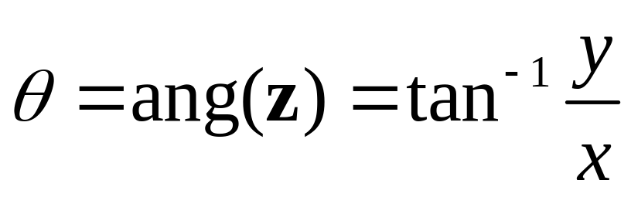
Conversion Between Forms

Slide 7
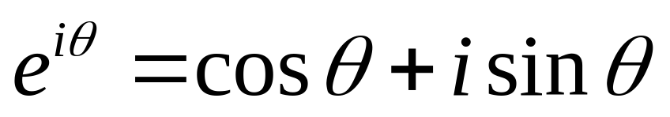
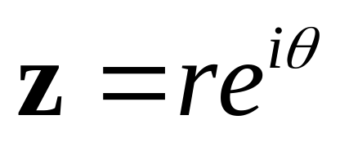
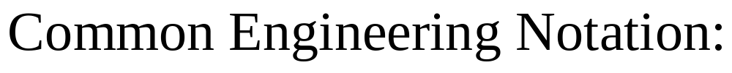
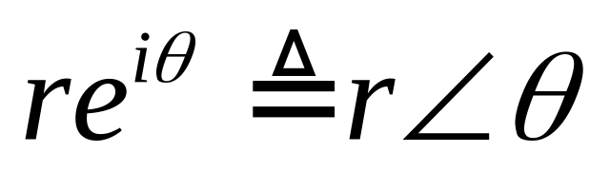
Euler’s Formula

Slide 8
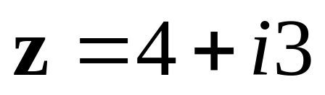
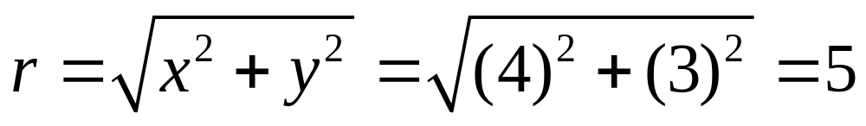
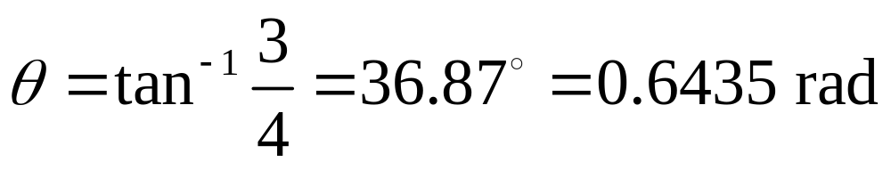
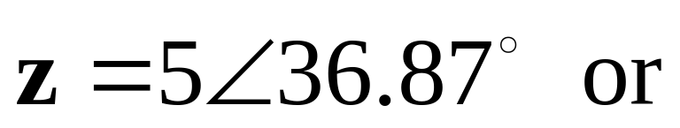
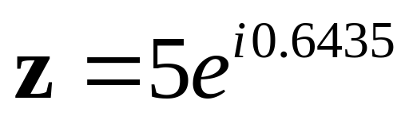
Example 15-1. Convert the following complex number to polar form:

Slide 9
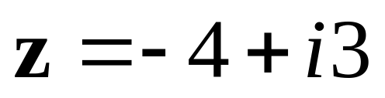
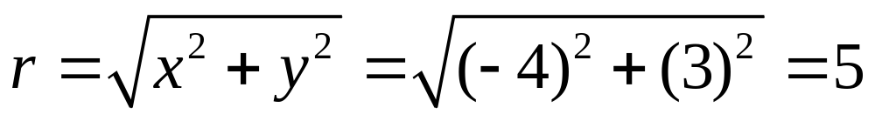
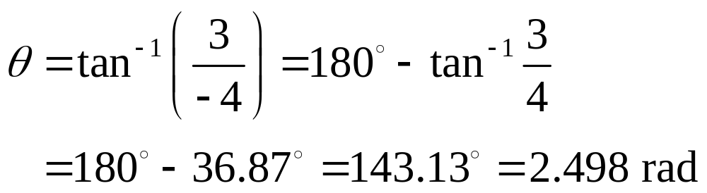
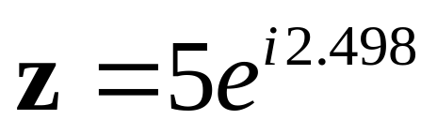
Example 15-2. Convert the following complex number to polar form:

Slide 10
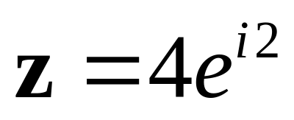
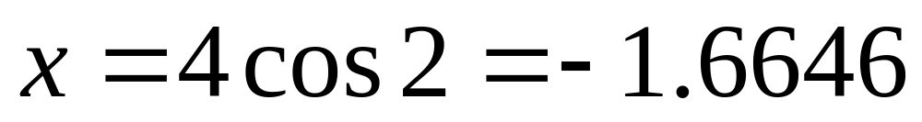
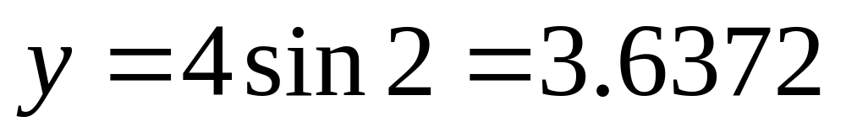
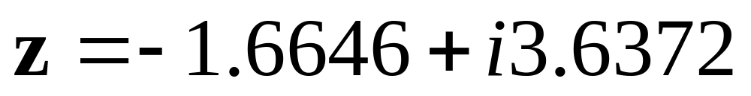
Example 15-3. Convert the following complex number to rectangular form:

Slide 11
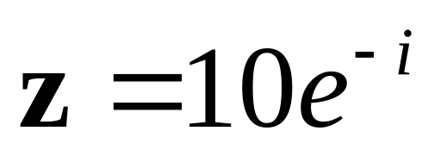
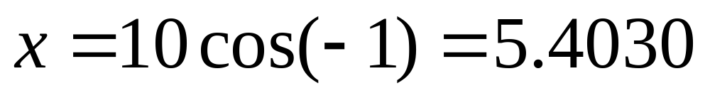
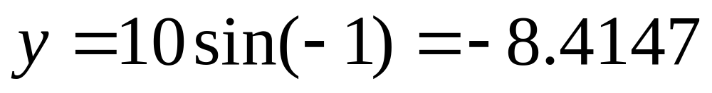
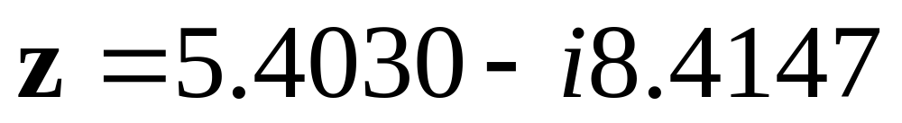
Example 15-4. Convert the following complex number to rectangular form:

Slide 12
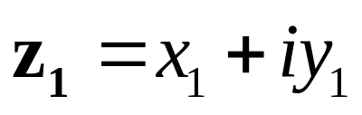
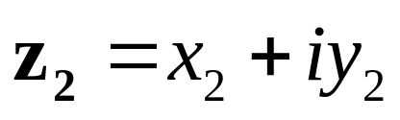
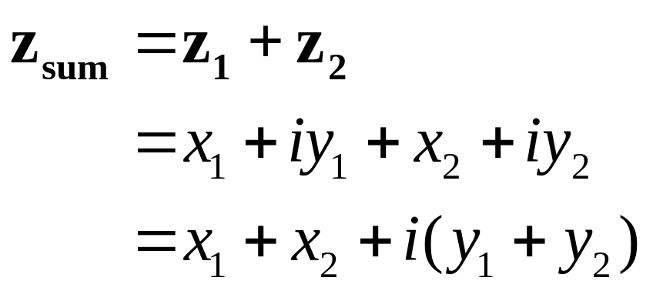
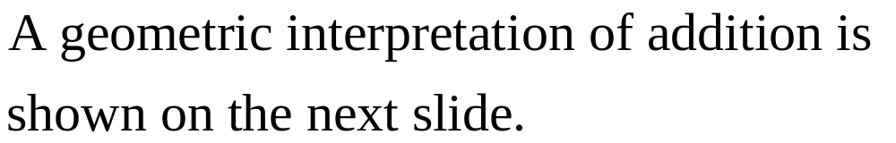
Addition of Two Complex Numbers

Slide 13
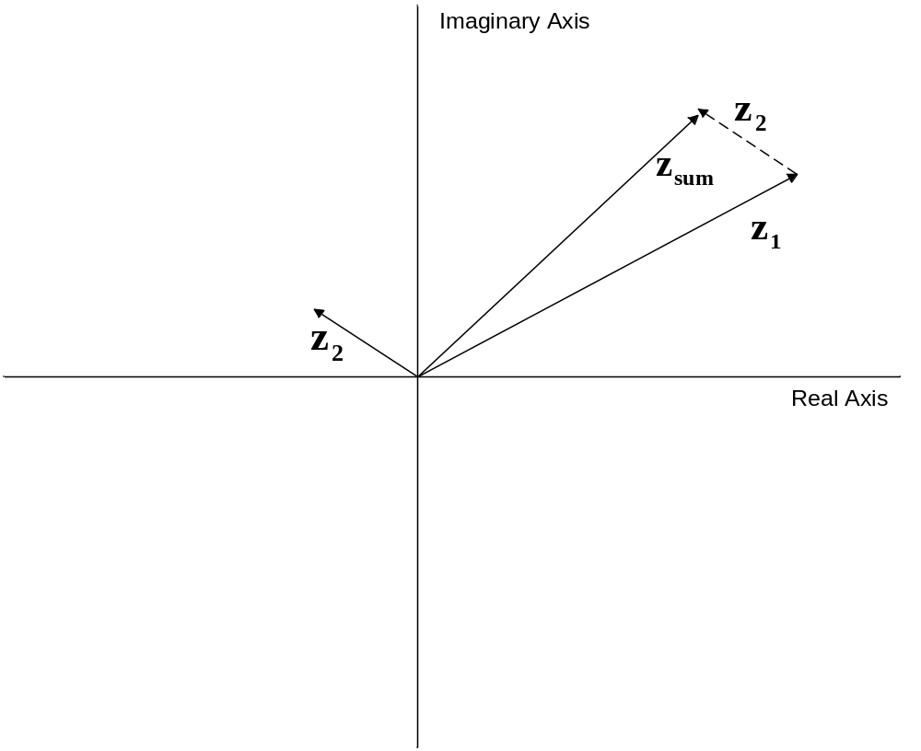
Addition of Two Complex Numbers

Slide 14
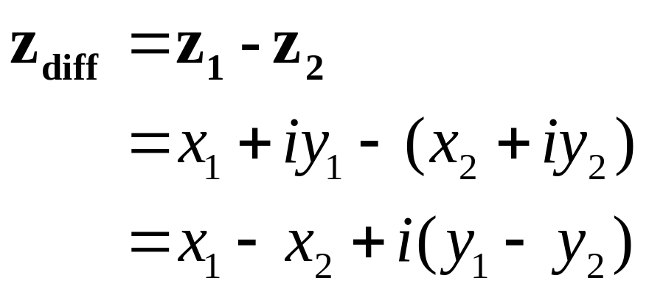
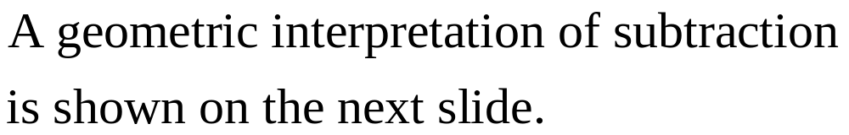
Subtraction of Two Complex Numbers

Slide 15
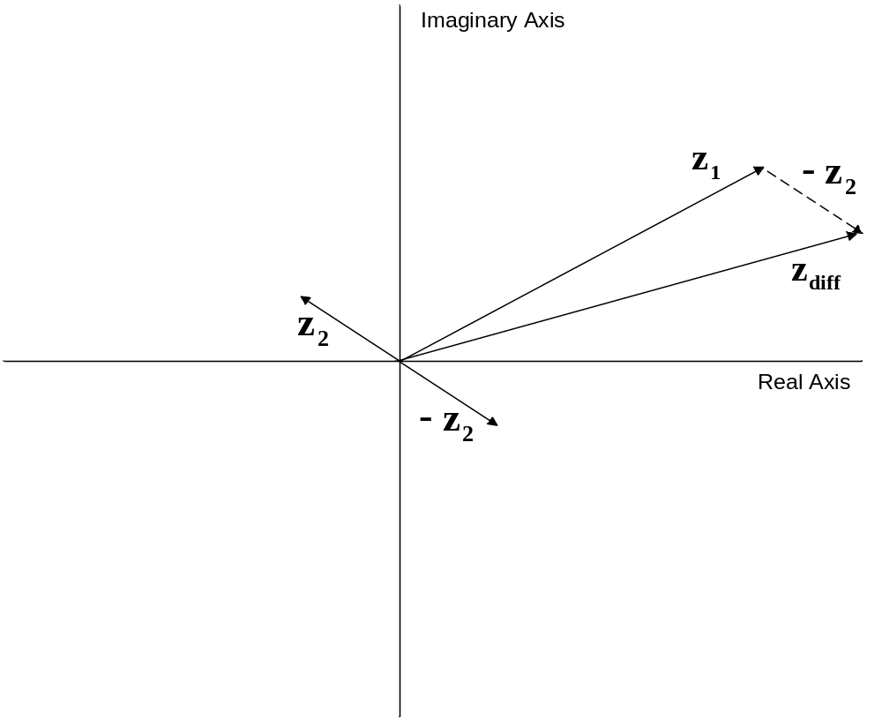
Subtraction of Two Complex Numbers

Slide 16
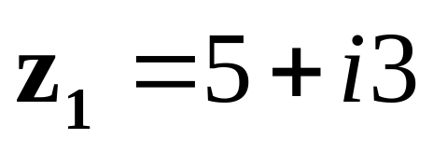
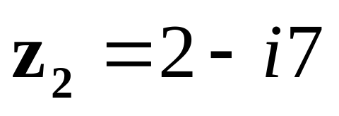
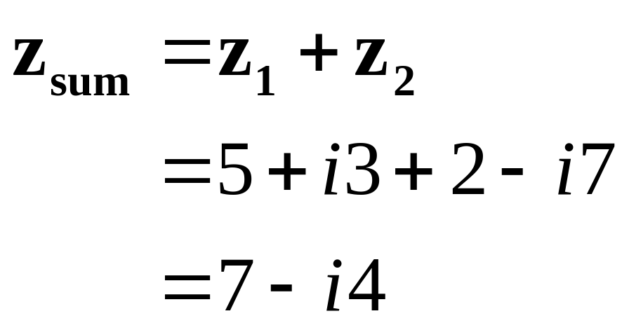
Example 15-5. Determine the sum of the following complex numbers:

Slide 17
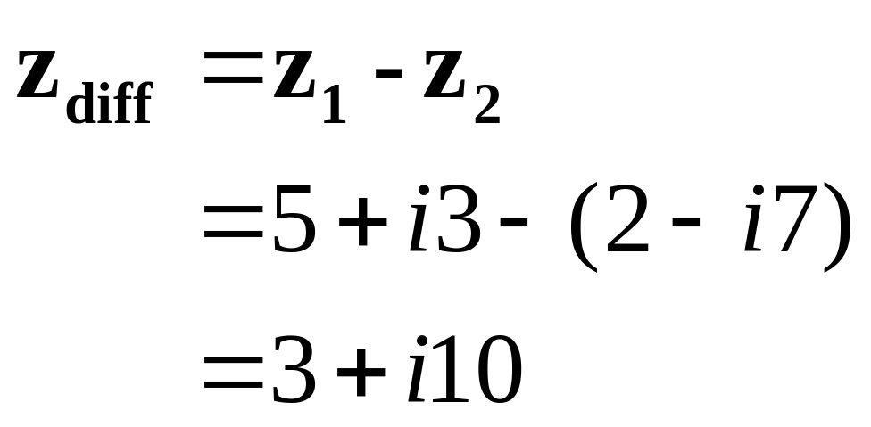
Example 15-6. For the numbers that follow, determine z_{diff} = z₁-z₂.

Slide 18
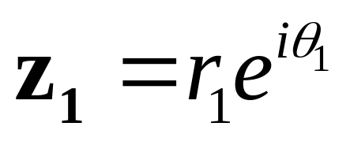
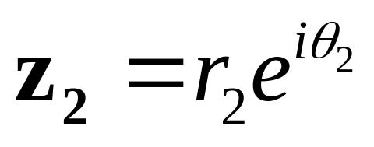
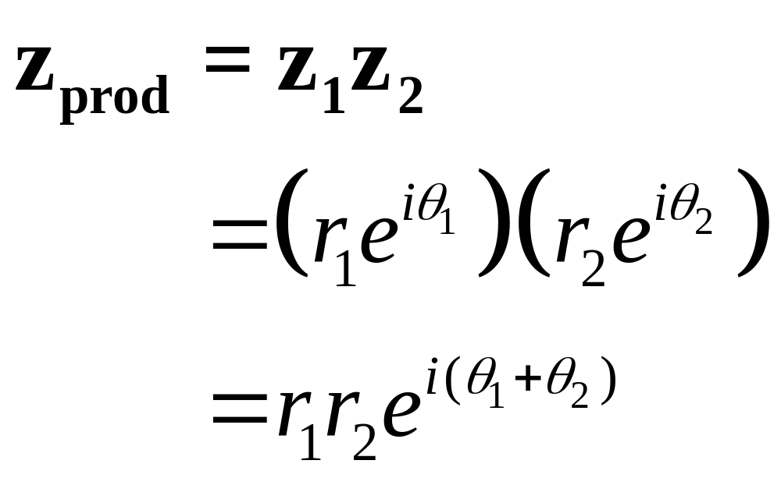
Multiplication in Polar Form

Slide 19
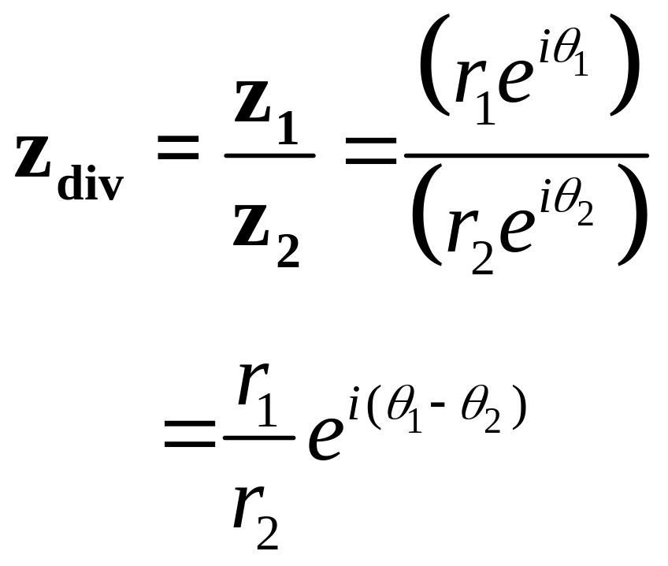
Division in Polar Form

Slide 20
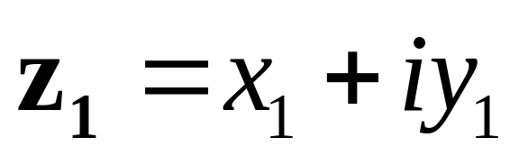
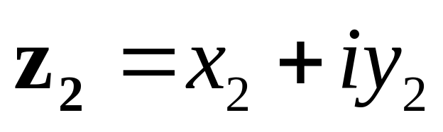
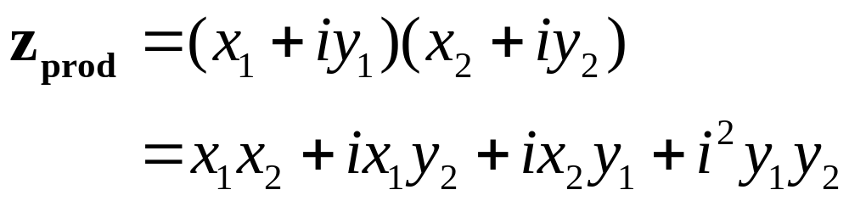
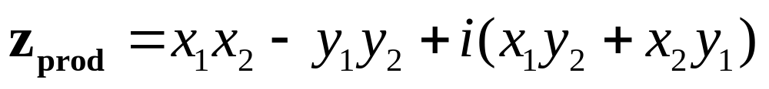
Multiplication in Rectangular Form

Slide 21
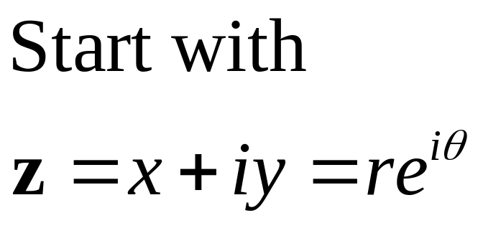


Complex Conjugate

Slide 22


Division in Rectangular Form

Slide 23




Example 15-7. Determine the product of the following 2 complex numbers:

Slide 24



Example 15-8. Repeat previous example using rectangular forms.

Slide 25


Example 15-9. Determine the quotient z₁/z₂ for the following 2 numbers:

Slide 26


Example 15-10. Repeat previous example using rectangular forms.

Slide 27




Exponentiation of Complex Numbers: Integer Power

Slide 28




Roots of Complex Numbers

Slide 29



Example 15-11. For the value of z below, determine z₆ = z⁶.

Slide 30






Example 15-12. Determine the 4 roots of s⁴ + 1 = 0.

Slide 31
MATLAB Complex Number Operations: Entering in Rectangular Form
>> z = 3 + 4i
z =
3.0000 + 4.0000i
>> z = 3 + 4j
z =
3.0000 + 4.0000i
The i or j may precede the value, but the multiplication symbol (*) is required.

Slide 32
MATLAB Complex Number Operations: Entering in Polar Form
>> z = 5*exp(0.9273i)
z =
3.0000 + 4.0000i
>> z = 5*exp((pi/180)*53.13i)
z =
3.0000 + 4.0000i
This result indicates that polar to rectangular conversion occurs automatically upon entering the number in polar form.

Slide 33
MATLAB Rectangular to Polar Conversion
>> z = 3 + 4i
z =
3.0000 + 4.0000i
>> r = abs(z)
r =
5
>> theta = angle(z)
theta =
0.9273

Slide 34
Other MATLAB Operations
>> z_conj = conj(z)
z_conj =
3.0000 - 4.0000i
>>real(z)
ans =
3
>> imag(z)
ans =
4

